Slide 1
Kiva fundraising analysis
A model to increase funding on kiva.org

Slide 2

Kiva’s mission

Slide 3
Kiva’s business model
Kiva is a crowdfunding website where people all over the world can make interest free loans to entrepreneurs worldwide
Funds are posted and disbursed by Kiva’s field partner organizations worldwide
At any point in time there are 4000 + entrepreneurs who need funding
If loans are not fully funded within 30 days of posting, they expire and no one gets the money
In this scenario, the field partner has to make the loan themselves, increasing a risk of loss exposure on their books

Slide 4
Motivation for analysis
Kiva’s field partners are small, non–profits who will run out of money assuming people are not able to pay back their loans on time
This analysis will help them post the loans most likely to get funded on Kiva and reduce exposures of losses on their books
By learning about which loans are mostly likely to get funded, they can focus their energy on promoting those aspects of the loan on the webpage

Slide 5
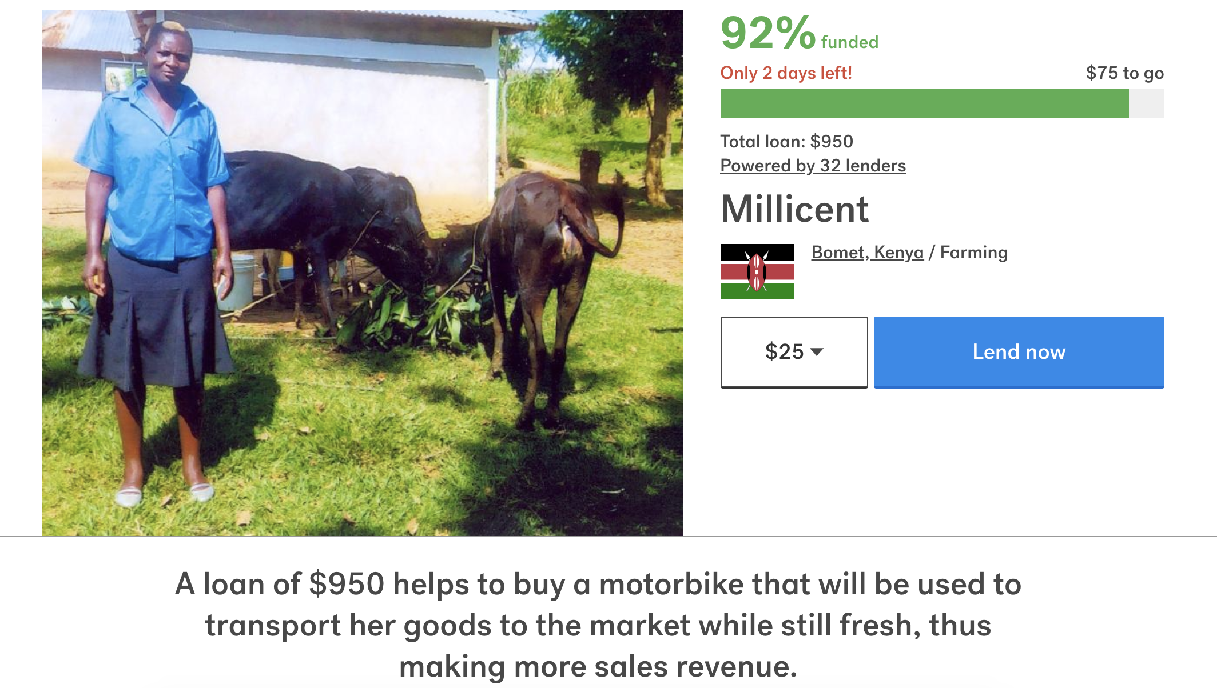
Example loan

Slide 6
Process
Analyze data
- Find trends in existing data that dictate if certain features are dominant among funded loans
Build Models
- Build a simple predictive model that provide signals on which loans will fund the best
Communicate to Stakeholders
- Use this output to make cohesive recommendations to field partners on how to increase probability of funding

Slide 7
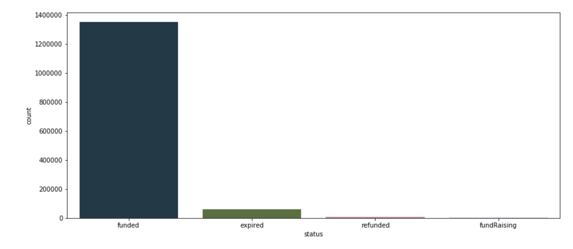
Exploratory analysis
Inherent skewness in data due to majority of the sample being funded loans

Slide 8
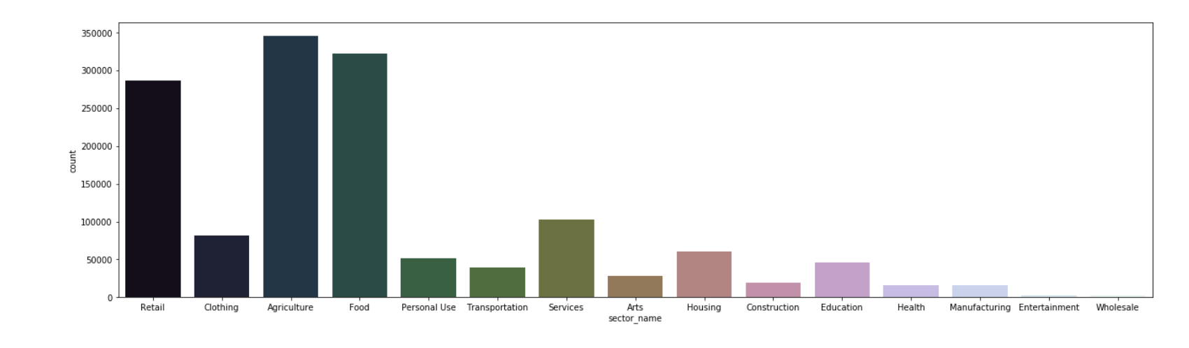
Exploratory analysis
Majority of borrowers are in the Agricultural sector which intuitively makes sense

Slide 9
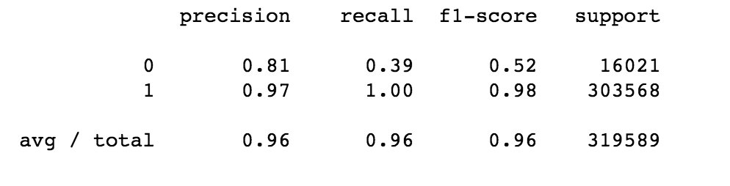
The models
1. Logistic Regression
Logistic regression is the regression analysis to conduct when the dependent variable is binary. In this case, loan_funded =1 and expired=0.
Results:
This model is good at determining if a loan will be funded, but not good at determining which loans will not fund. this is very likely to the class imbalance issue mentioned earlier.
The model correctly identifies 40% of all expired loans as "not funded"

Slide 10
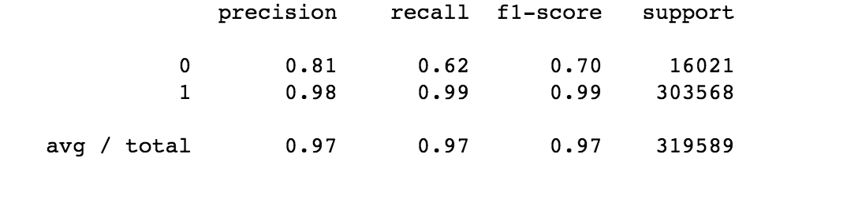
The models
2. Random Forest
Random Forest is a flexible, easy to use machine learning algorithm that produces, even without hyper-parameter tuning, a great result most of the time. It is also one of the most used algorithms, because it’s simplicity and the fact that it can be used for both classification and regression tasks.
Results:
This model is better than the previous one at determining which loans won’t be funded. It correctly identifies 62% of expired loans as “not funded”

Slide 11
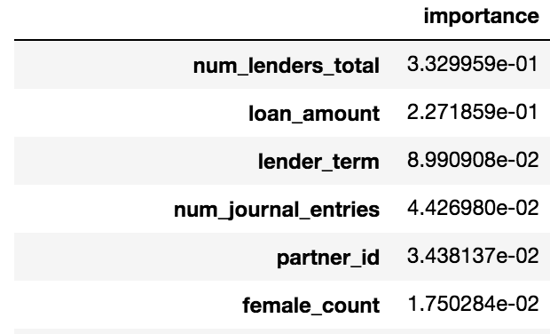
Feature importance

Slide 12
Recommendations
Loan Amount is a significant indictor of whether a loan will get funded or not. In general, smaller loan amounts have a higher probability to get funded
Shorter loan terms are more likely to be funded
Journal entries are significant! The partner should make an effort to write these as lenders are more likely to feel connected to the borrowers this way
Females are more likely to be funded than males. Partners should prioritize posting those loans.

